Slide 1

Informatics practices project 2025-2026
e-sports management
soham Khurana
D.A.V. Public School
Grade 12th division B

Slide 2
Acknowledgement
First of all, I extend my heartiest gratitude to my teacher ma’am under whose utmost guidance this work could take the recent shape.
I wish to express my deep gratitude and sincere thanks to Principal ma’am D.A.V. Public School for the encouragement and for all facilities that she provided for this project work.
I can’t forget to offer my sincere thanks to my classmates whose constant feedbacks make my project more effective. Lastly, I would like to thank my parents for their encouragement in fulfilling my project.

Slide 3
Index
Acknowledgement
Introduction
Project
conculsion

Slide 4
Introduction
The purpose of this project is to manage and organize information related to e-sports players in an easy and systematic way. It helps in storing important details such as player names, teams, games played, matches, wins and earnings in a structured format. The project makes it easier to maintain player records, update performance data and compare players based on their achievements. It also helps in analyzing player performance through simple calculations and visual representation. Overall, this project aims to provide a basic system for managing e-sports tournament data efficiently and accurately.

Slide 5
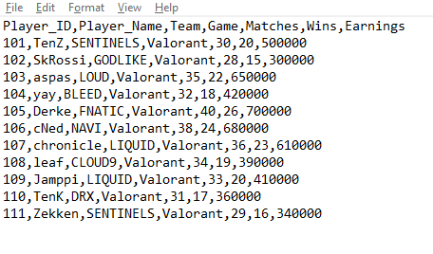
Project
import pandas as pd
import matplotlib.pyplot as plt
FILE_NAME = "valorant_players.csv"
while True:
print("\n====== Valorant Tournament Menu ======")
print("1. Display all players")
print("2. Add new Valorant player")
print("3. Search players by team")
print("4. Update player wins")
print("5. Show top performer")
print("6. Show KDA graph")
print("7. Show total earnings")
print("8. Show players with wins greater than given value")
choice = int(input("Enter your choice: "))
# Read CSV file
df = pd.read_csv(FILE_NAME)
df.columns = df.columns.str.strip()
This is the csv file that has been used in the code in notepad

Slide 6
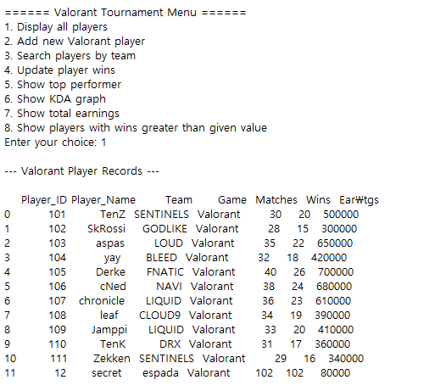
# 1. Display all players
if choice == 1:
print("\n--- Valorant Player Records ---\n")
print(df)

Slide 7
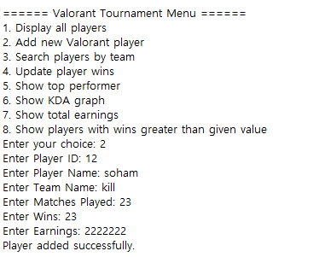
# 2. Add new player
elif choice == 2:
pid = int(input("Enter Player ID: "))
name = input("Enter Player Name: ")
team = input("Enter Team Name: ")
matches = int(input("Enter Matches Played: "))
wins = int(input("Enter Wins: "))
earnings = int(input("Enter Earnings: "))
df.loc[len(df)] = [pid, name, team, "Valorant", matches, wins, earnings]
df.to_csv(FILE_NAME, index=False)
print("Player added successfully.")

Slide 8
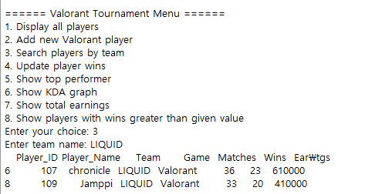
# 3. Search players by team
elif choice == 3:
t = input("Enter team name: ")
result = df[df["Team"] == t]
if result.empty:
print("No players found.")
else:
print(result)

Slide 9
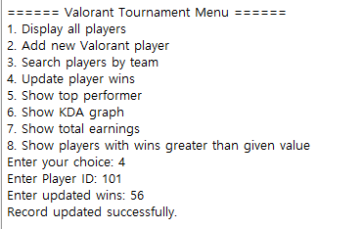
# 4. Update player wins
elif choice == 4:
pid = int(input("Enter Player ID: "))
new_wins = int(input("Enter updated wins: "))
if pid in df["Player_ID"].values:
df.loc[df["Player_ID"] == pid, "Wins"] = new_wins
df.to_csv(FILE_NAME, index=False)
print("Record updated successfully.")
else:
print("Player not found.")

Slide 10
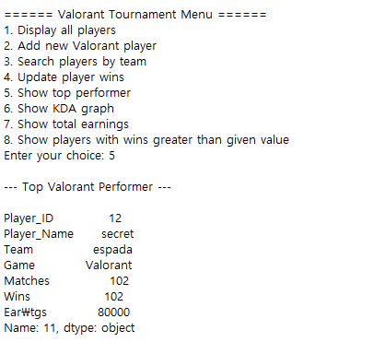
# 5. Show top performer
elif choice == 5:
top = df.loc[df["Wins"].idxmax()]
print("\n--- Top Valorant Performer ---\n")
print(top)

Slide 11
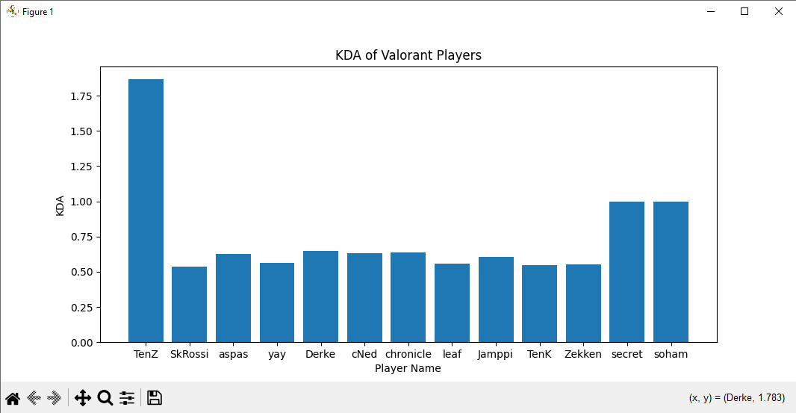
# 6. Show KDA graph
elif choice == 6:
df["KDA"] = df["Wins"] / df["Matches"]
plt.bar(df["Player_Name"], df["KDA"])
plt.xlabel("Player Name")
plt.ylabel("KDA")
plt.title("KDA of Valorant Players")
plt.show()

Slide 12
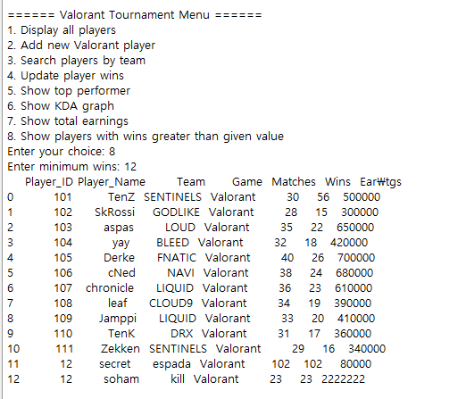
# 8. Players with wins greater than given value
elif choice == 8:
w = int(input("Enter minimum wins: "))
result = df[df["Wins"] > w]
if result.empty:
print("No players found.")
else:
print(result)
else:
print("Invalid choice.")

Slide 13
This project helped in understanding how e-sports player information can be managed in an organized manner. It made it easier to store, update and analyze player records such as matches, wins and earnings. The project also helped in learning how data can be represented visually to compare player performance. Overall, this project improved my understanding of handling data efficiently and showed how basic data management can be applied to real-life e-sports scenarios.

